Slide 1
Depixelizing Pixel Art in Real Time
Team:
M10615003 陳彥霖
M10615107 黃弘文

Slide 2



Background (Pixel-art scaling)
Our goal
Part | Time (ms)
SimilarGraph | 0.011456
Valence | 0.015456
EliminateCross | 0.059136
CellGraph | 0.018688
Optimize | 0.034176
CorrectedPositions | 0.005536
Rasterizer(600x600) | 7.17059
Total | 7.315038
Black Box
(Real Time)

Slide 3


Other Source Image

Slide 4
Performance X Texture Size
Image Size 256*224 | Time (ms)
SimilarGraph | 0.122528
Valence | 0.135712
EliminateCross | 0.20608
CellGraph | 0.384992
Optimize | 0.447392
CorrectedPositions | 0.016768
Rasterizer(600x600) | 6.1752
Total | 6.48867
Image Size 18*18 | Time (ms)
SimilarGraph | 0.011456
Valence | 0.015456
EliminateCross | 0.059136
CellGraph | 0.018688
Optimize | 0.034176
CorrectedPositions | 0.005536
Rasterizer(600x600) | 7.17059
Total | 7.315038
Image Size 256*224 | Time (ms)
SimilarGraph | 0.112096
Valence | 0.137728
EliminateCross | 0.206144
CellGraph | 0.3888
Optimize | 0.442368
CorrectedPositions | 0.017056
Rasterizer(1600x1400) | 36.424
Total | 37.728192
Image Size 18*18 | Time (ms)
SimilarGraph | 0.011392
Valence | 0.015264
EliminateCross | 0.05904
CellGraph | 0.01904
Optimize | 0.034176
CorrectedPositions | 0.00544
Rasterizer(1500x1500) | 37.7949
Total | 37.939252

Slide 5
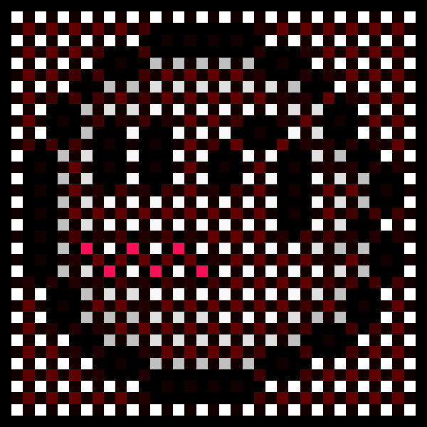
Time Complexity Analysis
Algorithm : Per-Pixel Compare with neighbors
CPU Time : Relate to Pixels
GPU Time : Relate to Pixels/threads

Slide 6
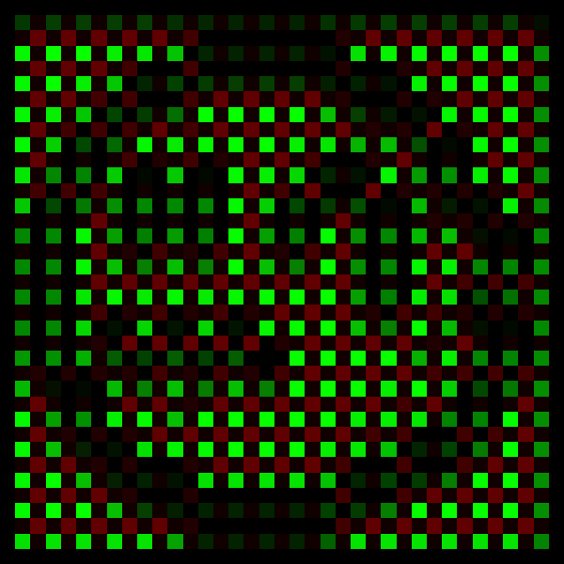
Time Complexity Analysis cont.
Algorithm :
Per-Pixel Encode 8 ways Information To char
CPU Time : Relate to Pixels
GPU Time : Relate to Pixels/threads

Slide 7
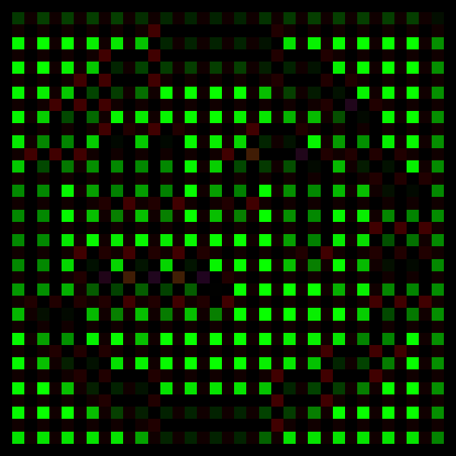
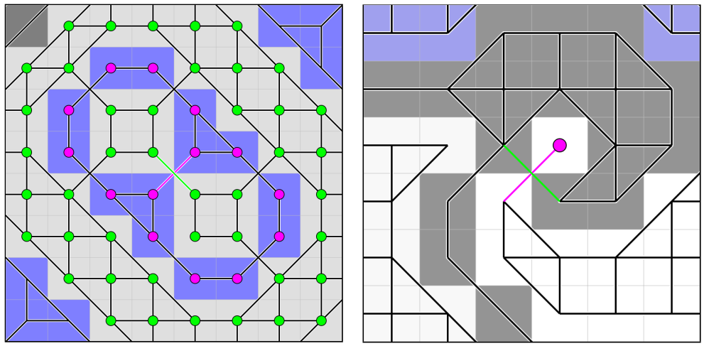
Time Complexity Analysis cont.
Algorithm :
Delete Fully Connected
Cross Edge Solve(Curve, Island, Sparse Pixel)
CPU Time | GPU Time
Curve Length | Curve Length
Constant | Constant
Constant | Constant

Slide 8
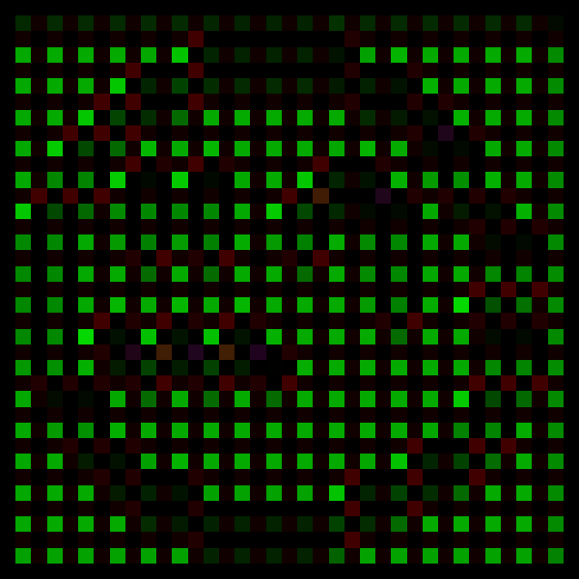
Time Complexity Analysis cont.
Algorithm : Per-Pixel Encode 8 ways Information
CPU Time : Relate to Pixels
GPU Time : Relate to Pixels/threads

Slide 9

Time Complexity Analysis cont.
Algorithm : Get 3x3 Cell for every Pixel Consider
Every Combination Case by Case
CPU Time : Big Constant * Pixels
GPU Time : Big Constant * Pixels / threads

Slide 10
Time Complexity Analysis cont.
Algorithm : Get two Splines in Cell and four splines connected by them
Smooth the gradient between
CPU Time : Big Constant * Pixels
GPU Time : Big Constant * Pixels / threads

Slide 11
Time Complexity Analysis cont.
Algorithm : Rasterize Every Pixel By deal with Up to two splines in Every cell
By determinate inside/outside two splines
CPU Time : Big Constant * Pixels
GPU Time : Big Constant * Pixels / threads

Slide 12
Thank You

